Slide 1
CUSTOMER SHOPPING BEHAVIOR
Customer
shopping behavior
Turn 3,900 retail transactions into a focused growth agenda across loyalty, subscriptions, discounts, and product mix.

Slide 2
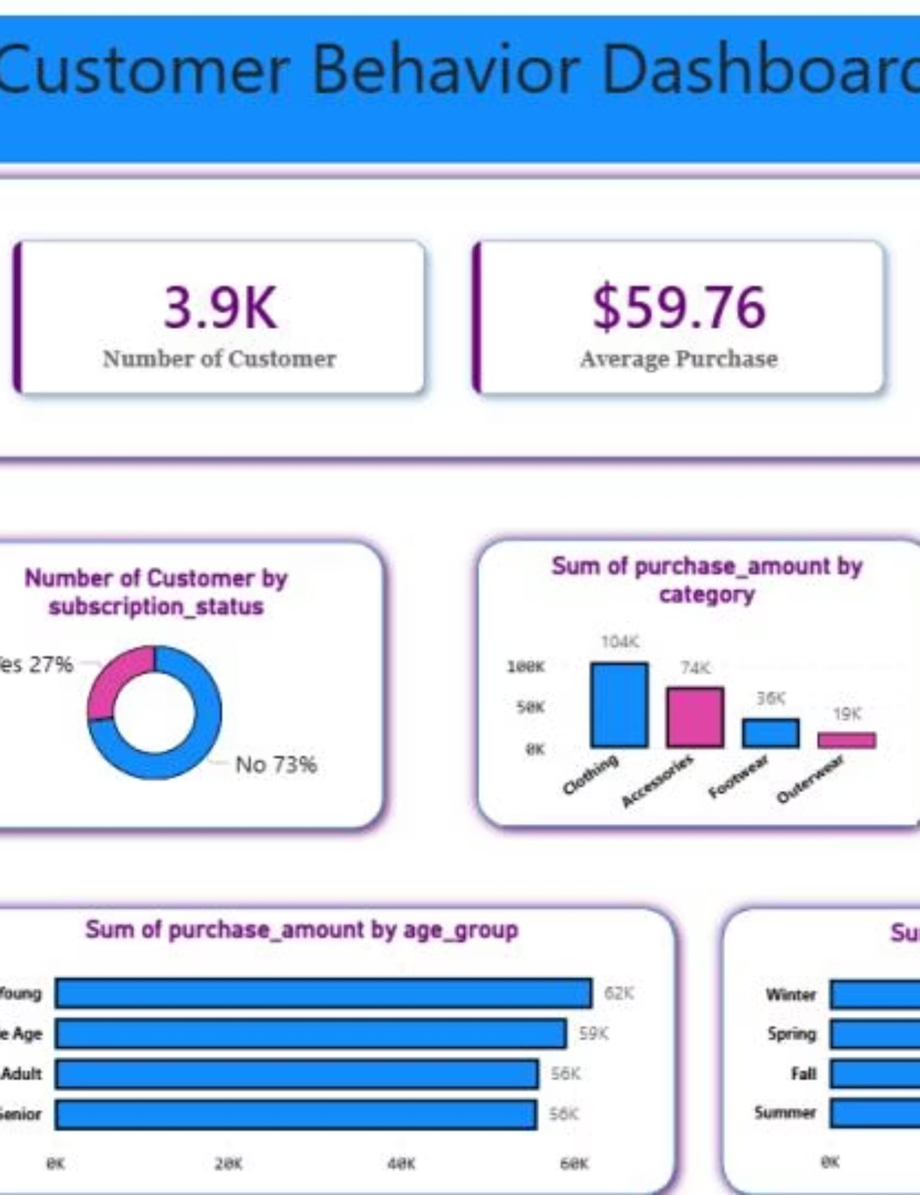
01 · CUSTOMER BASE
The business has a loyal base, but subscriptions lag
3,900 purchases
1
3,116 loyal customers vs. 701 returning and 83 new
2
27% subscribe; 73% do not
3
02 / 10

Slide 3
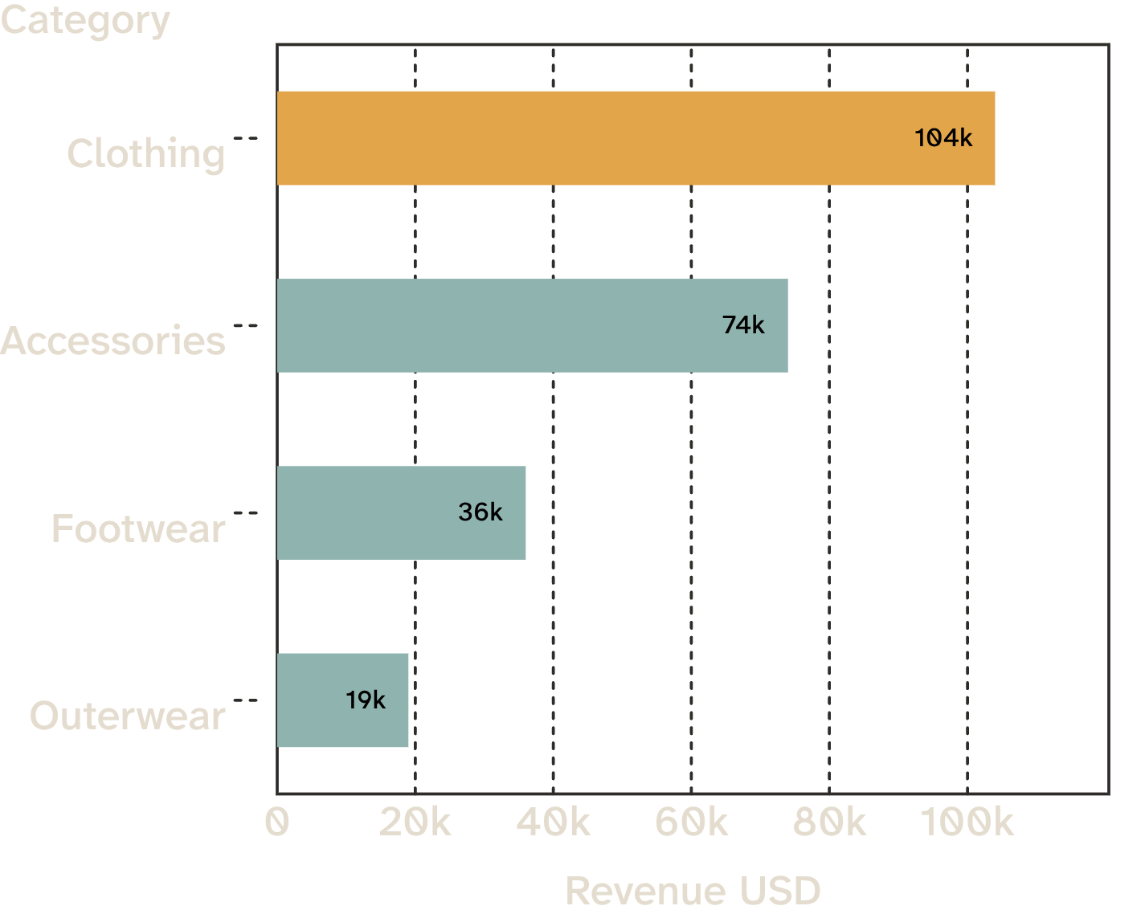
02 · PRODUCT MIX
Revenue is concentrated in clothing and accessories
Clothing generates the largest revenue pool, with accessories next; footwear and outerwear are materially smaller.
Revenue by category · USD
03 / 10

Slide 4
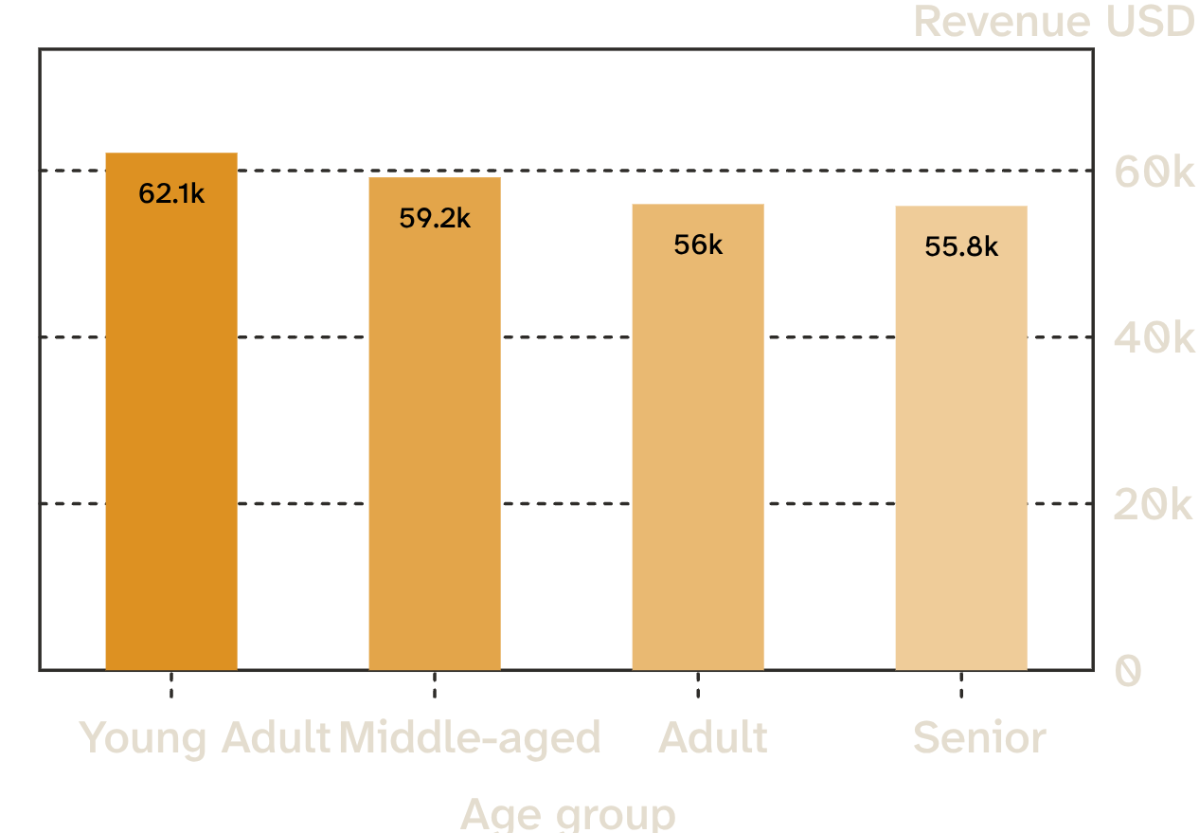
03 · CUSTOMER COHORTS
Young adults are the largest revenue cohort
Young adults contribute the most revenue, but the four cohorts are relatively close together.
Young Adult: $62K
Middle-aged: $59K
Adult: $56K
Senior: $56K
04 / 10

Slide 5
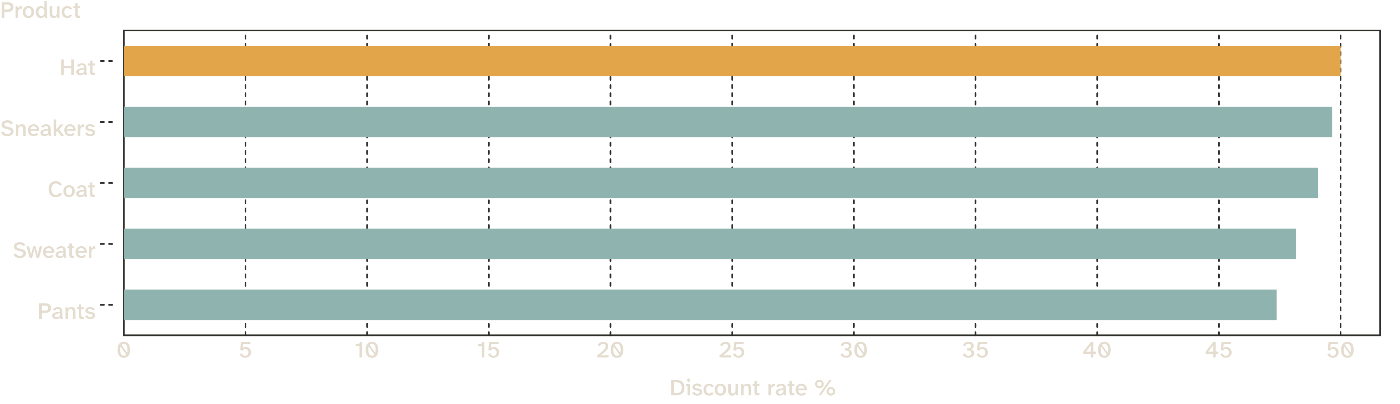
04 · DISCOUNT DEPENDENCE
Discounts are concentrated in a few products
Hat, sneakers, coat, sweater, and pants have the highest share of discounted purchases, each near half of orders.
05 / 10

Slide 6
05 · SUBSCRIPTION ECONOMICS
Subscribers spend about the same per purchase
Total revenue
AVERAGE SPEND
$62.6K from subscribers vs. $170.4K from non-subscribers.
$59.49 for subscribers
$59.87 for non-subscribers
Subscription is a relationship and retention lever, not yet a higher-basket lever.
06 / 10

Slide 7
06 · DISCOUNTED CUSTOMERS
High-value behavior already exists inside discount usage
839
customers used discounts and still spent above the average purchase amount
Keep discounts targeted: reward intent and frequency instead of training every shopper to wait.
Average purchase amount: $59.76
07 / 10

Slide 8
07 · MERCHANDISING SIGNALS
Product signals point to a sharper merchandising story
01
02
Build trust
Anchor campaigns
Top-rated: gloves 3.86, sandals 3.84, boots 3.82, hat 3.80, skirt 3.78.
Top sellers by category: jewelry, blouse, sandals, and jacket lead their categories.
Use top-rated products to build trust; use best sellers to anchor campaigns.
08 / 10

Slide 9
08 · GROWTH AGENDA
Three moves to improve the economics
01
02
03
Grow subscriptions
Protect margin
Target the right moments
Package exclusive benefits around repeat behavior.
Review discount-heavy products and test narrower offers.
Focus campaigns on young adults, loyal customers, and express-shipping users.
09 / 10

Slide 10
Track: subscription conversion and repeat purchase rate
09 · NEXT TEST CYCLE
1
From analysis
to action
Test: benefit-led subscription messaging vs. blanket discounts
2
Use the dashboard to monitor subscription lift, discount dependence, product mix, and age-cohort revenue as the next test cycle runs.
Scale: campaigns that pair high-rated products with loyal segments
3
10 / 10

